Slide 1


9. Numbers and distributions
Mrinal Vashisth
PhD Year 2, Computational Psychometrics, TSU, RF
M.Sc. Human Development: Genetics, Neuroscience and Psychology, TSU, RF
M.S. Applied Mathematics and Information Technology (Systems Biology and Bioinformatics), ITMO, RF
B.Tech. Biotechnology, JNU, RI

Slide 2
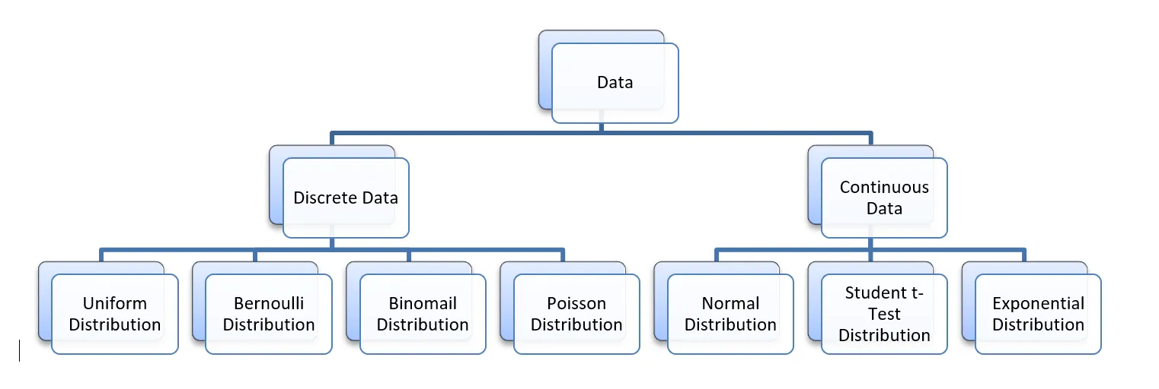
Fundamentals
https://www.corpnce.com/understanding-the-different-types-of-probability-distribution-curves-in-statistics/
https://vankessel.io/visualizing-complex-functions

Slide 3
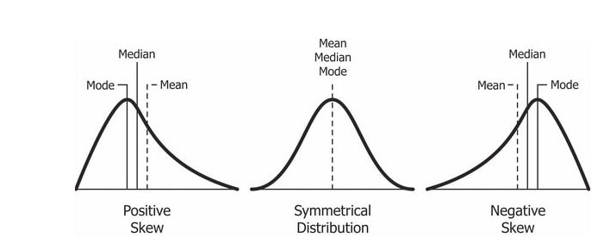

Slide 4
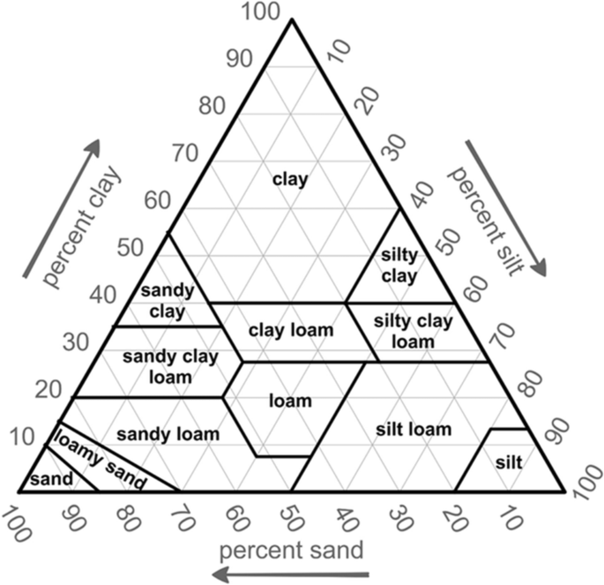
Mixtures
https://www.nature.com/articles/srep04516
https://link.springer.com/article/10.1007/s00477-020-01900-2

Slide 5
Go to Jupyter notebook 10

